Slide 1

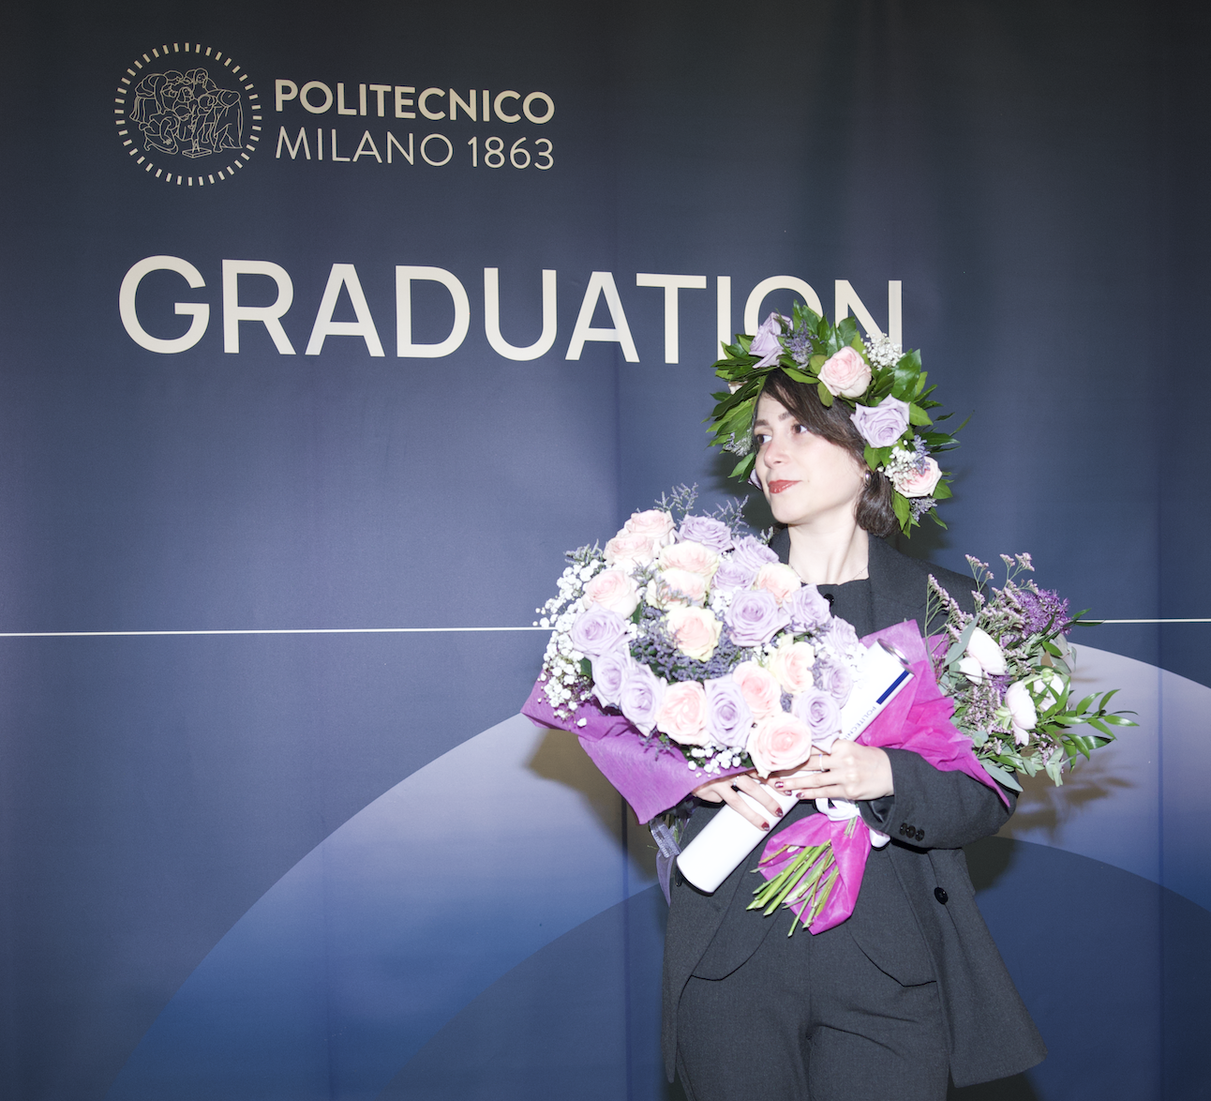
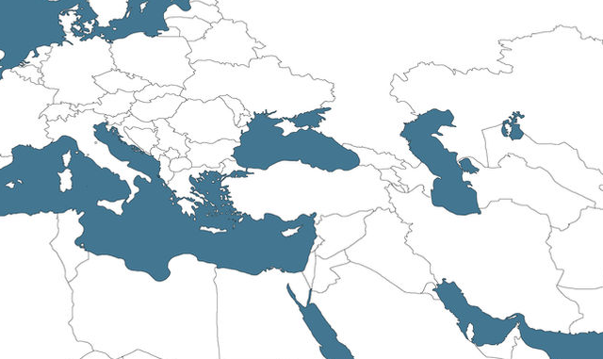




Farnoosh Rostami
University: Politecnico di Milano
Study program: Building and Architecture Engineering
Year of study: Graduated
City: Milan, Italy
Motto for life: Small but consistent steps create big impact.
Hobbies: Skating, Bicycling, Photography, Sketching
My expectations from the summer school: Get hands-on exposure to renewable energy and building technologies.
Where I want to find a job and live
”GERMANY”
Where I was born “IRAN”
Where I studied
“ITALY”
Karlsruhe
31 August to 11 September 2026

